Slide 1

4th Grade Parent’s Night Information
2025-2026
Baggett Elementary School ~ 948 Williams Lake Road, Powder Springs, GA 30127
Principal: Dr. Alisha Queen ~ 678-460-1570
Notes:
Dr. Daniel

Slide 2

Daily Schedule
Because 4th grade is departmentalized this year, the students will be going to different teachers throughout the day for each subject area, so their schedules will vary. Students will keep a copy of their daily schedule in their folders. For specific questions about your child’s schedule, please contact his or her homeroom teacher.
Kaley Curran: kaleyn.curran46@paulding.k12.ga.us
Ashley Devan: ashleyndevan61@paulding.k12.ga.usus
Beth Knott:
bknott@paulding.k12.ga.us
Jennie Wilson:
jdwilson@paulding.k12.ga.us
Notes:
Dr. Daniel

Slide 3

Communication
4th Grade Weekly Newsletter
E-mail
Class Dojo
All of the 4th grade teachers will use Class Dojo as our primary means of communicating with parents this year, so if you have not already signed up, please contact your homeroom teacher for instructions.
In addition, we will send home a weekly or bi-weekly newsletter with important dates and upcoming events. Whole class communications may also be sent out via email.

Slide 4
Homework
This year, school administrators have decided to give students and parents a break from homework so that students can spend more time with family and doing extra-curricular activities.
Therefore, students will have no required weekly homework, but we highly encourage students to spend at least 20 minutes reading as well as practicing multiplication and division facts each night.

Slide 5

Daily Folders
The first day of school, we set up your child’s folder for a successful year. In the folder you will find a copy of your child’s schedule as well as a specials calendar.
We try to remind the students to keep their take home folders neat and organized.
Throughout the week, please make sure your child has cleaned out his/her folder of any loose papers. This will help to keep them clean and organized.
Please check your child’s folder EVERY night for important papers and notes. Please initial the calendar nightly if possible.

Slide 6

Wednesday Folder
Every Wednesday, your child will be sent home with a blue folder. In this folder, you will find your child’s work from the week, as well as important notes/flyers.
Please make sure you look at all the papers, take them out, and sign the page on the front cover next to the correct date. This lets us know you have received the folder and viewed its contents. Any forms that need to be signed and returned may be returned in the folder.
Please return the next day if possible.

Slide 7
Snacks
Because our lunch is so early this year, we will have a snack time each afternoon. Please send in a healthy snack for your child. They will not be allowed to eat candy as a snack!
If you would like to donate individually wrapped snacks to the class, you may do so. Teachers do not keep snacks for students who do not bring one.
For birthdays, your child may bring in a treat to share with the entire class. This may include, cupcakes, cookies, etc. Remember, only store bought please. No homemade goodies. Please let us know in advance if you plan to send something in. Thank you.

Slide 8
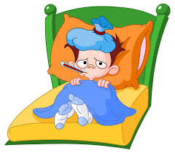
Absences & Tardies
We know that children get sick. If your child misses a day of school, you must send in either a parent note or doctor’s note for the absence to be excused.
You are allowed 3 parent notes per semester.
We will contact you on the third unexcused absence.
Students are considered tardy if they are not in the classroom at 8:00 am.

Slide 9
Transportation
We are unable to take a student’s word for a transportation change.
Communicate in a written note if your child will go home differently than what they normally do. Please sign and date the note so we know you sent it.
Teachers can not accept transportation changes via email, or Class Dojo. Please contact the front office.

Slide 10

Word Study
We are all used to a weekly spelling list and memorizing spelling words. Guess what happens 2 weeks later when students need to use one of those words in their writing? They’ve forgotten how to spell it!
This is the primary reason that we focus on chunking words into syllables and spelling one syllable at a time using the strategies that we use and discuss daily.

Slide 11

Word Study
According to the authors of our Bookworms Literacy Curriculum, “Chunking words into syllables is an aid in decoding, spelling, and meaning. Multisyllabic word study words can be analyzed at the syllable level. The goal of this instruction is to build flexible strategies for attacking unknown words.”
To help you understand a little better, here is the process that we use in order to spell an unknown word.

Slide 12
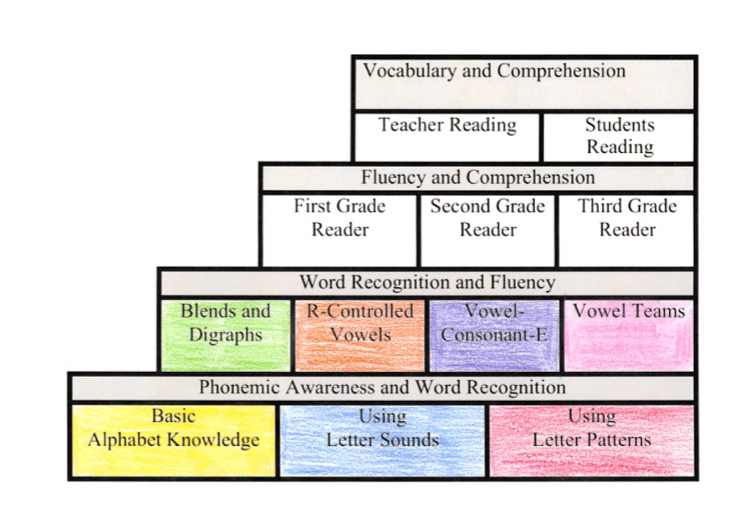
What is DI and where should my child be at the end of the year?
Small group instruction
Based upon student’s needs
Phonics, fluency, and comprehension based.
End of year goal: Vocabulary and Comprehension
Notes:
Dr. Daniel

Slide 13

What is reading fluency?
Fluency is the ability to read a text accurately quickly, and with expression. Fluency is important because it provides a bridge between word recognition and comprehension.
End of year goal:
115
wcpm
Notes:
Dr. Daniel

Slide 14
Access to Grades
Grading will be different this year. Report card grades will be based on a grading scale. A parent letter will be coming from the district regarding grading.
  *A: 90-100
  *B: 80-89
  *C: 70-79
  *F: Below 70
Report cards will only be available on Parent Portal.
Activating a Parent Portal Account Please send an email to portal@paulding.k12.ga.us and the following information. A copy of parent picture id must also be included in the email. • Parent Name • Parent Physical Address • Parent Email Address • Student First Name • Student Last Name • Student’s Date of Birth • Student(s) Physical Address • Name of School Student Attends

Slide 15
Ga Milestones Assessment
The Georgia Milestones Assessments are a yearly end-of-grade measure of student achievement taking place in grades 3-8. GMA questions assess student’s knowledge over grade level standards.​
English Language Arts (ELA) (taken in 2 parts)​
Mathematics (taken in 1 part)​
Students in 3rd and 4th grade only take ELA and Math sections​
​

Slide 16
Parent Involvement
The Parent Resource Center in in the Media Center
Hours: 7:30 - 3:00 (follow directions for check out procedures)
If you need more information about the Parent Resource Center contact Julie Holmes Jholmes@paulding.k12.ga.us
Family Nights will be held throughout the year. More Information Coming Soon!

Slide 17

Keep up the Good Work…
Keep a check on newsletters.
Make sure to check folders each night.
Practice reading with your child for fluency and comprehension.
Practice math facts.
Work with your child on areas of need.
Notes:
Dr. Daniel

